Slide 1
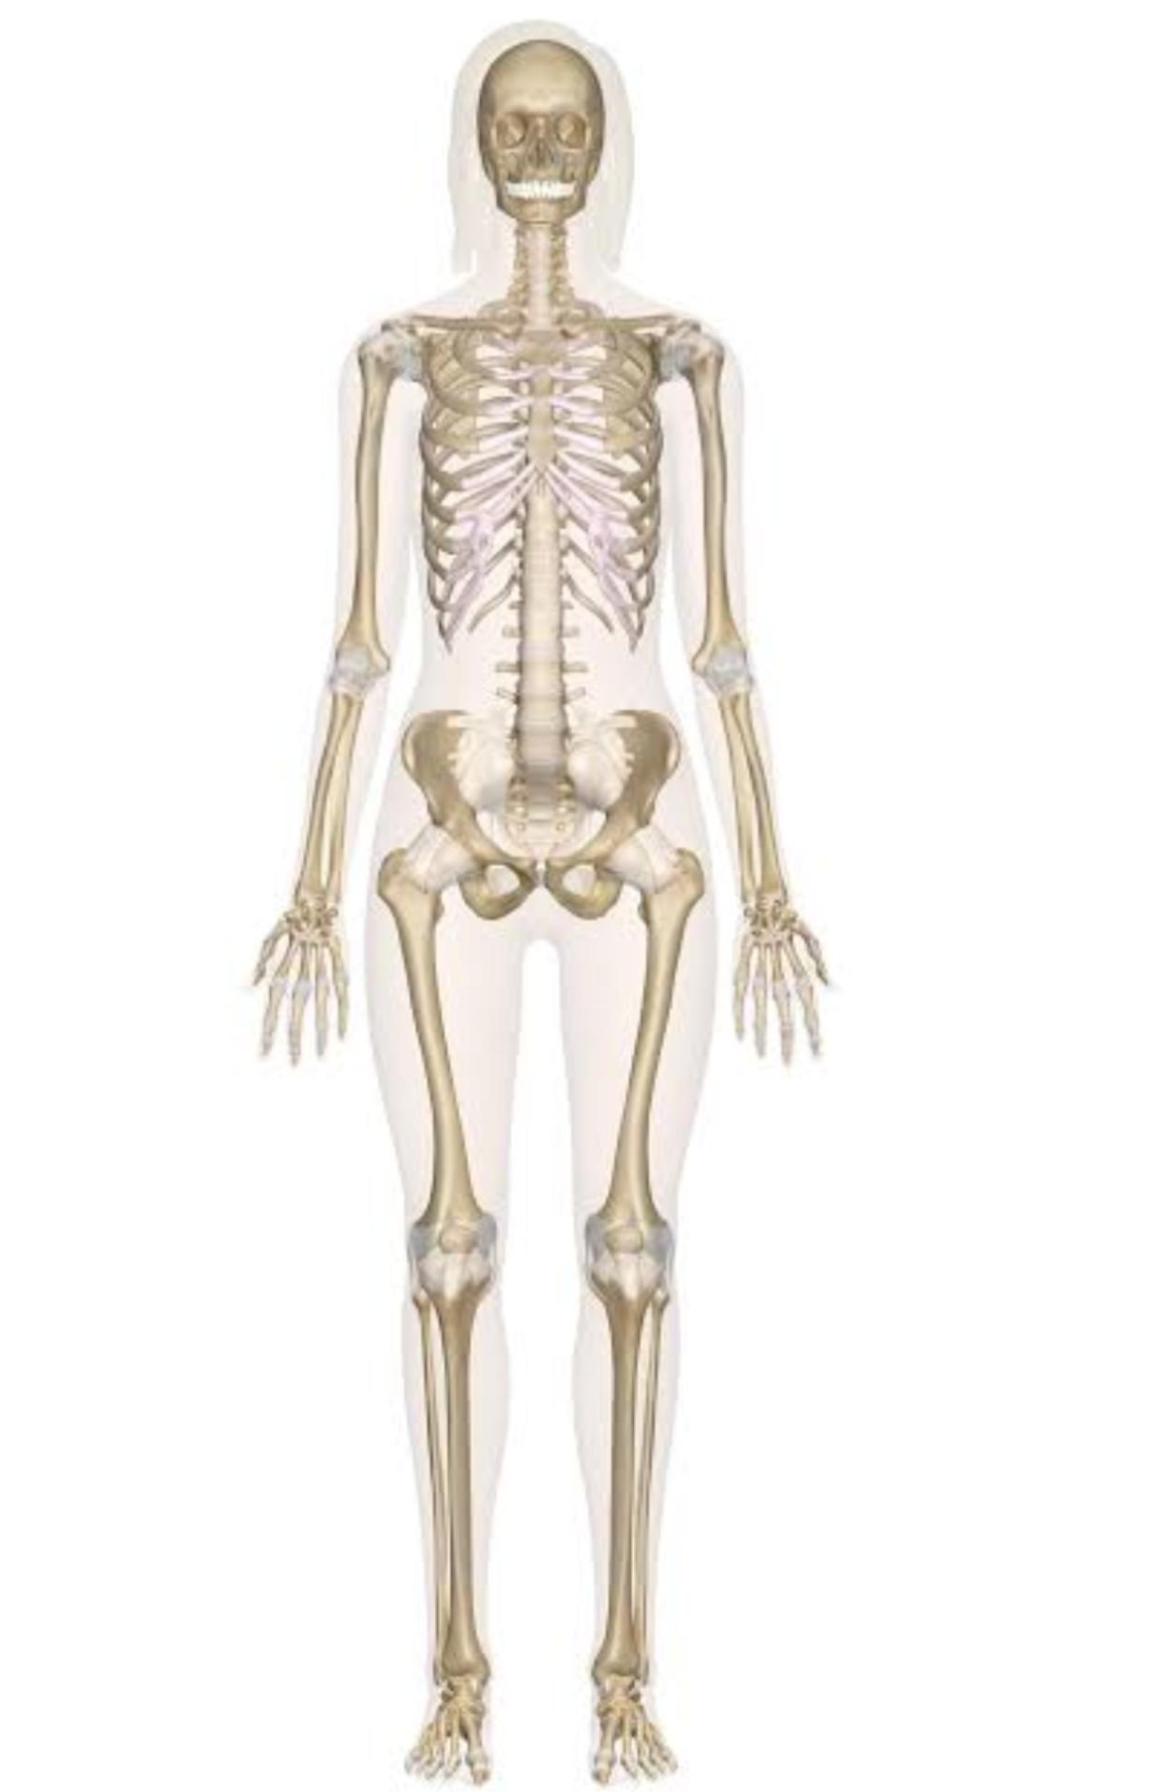
SKELETAL SYSTEM

Slide 2
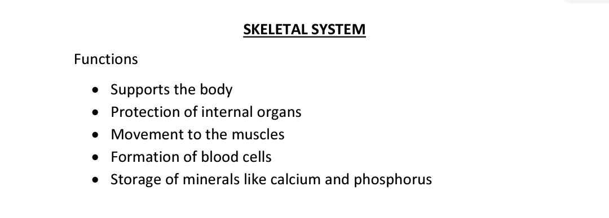

Slide 3
Bone is a strong and durable type of connective tissue.
It consists of:
• water (25%)
• organic constituents including osteoid (the carbon containing part of the matrix) and bone cells (25%)
• inorganic constituents, mainly calcium phosphate (50%).

Slide 4
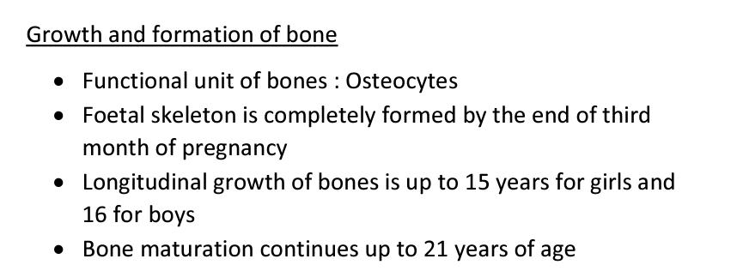

Slide 5
BONE CELLS
• Functional unit of bone is called osteocyte.
• It develops from germ cells called osteoblasts.
• The repairing cells of bones are called osteoclasts.

Slide 6
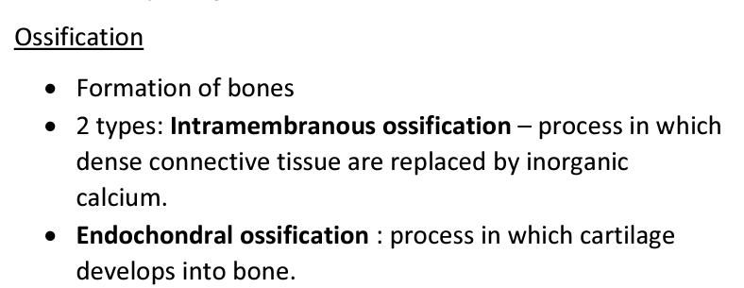
(Osteogenesis)

Slide 7
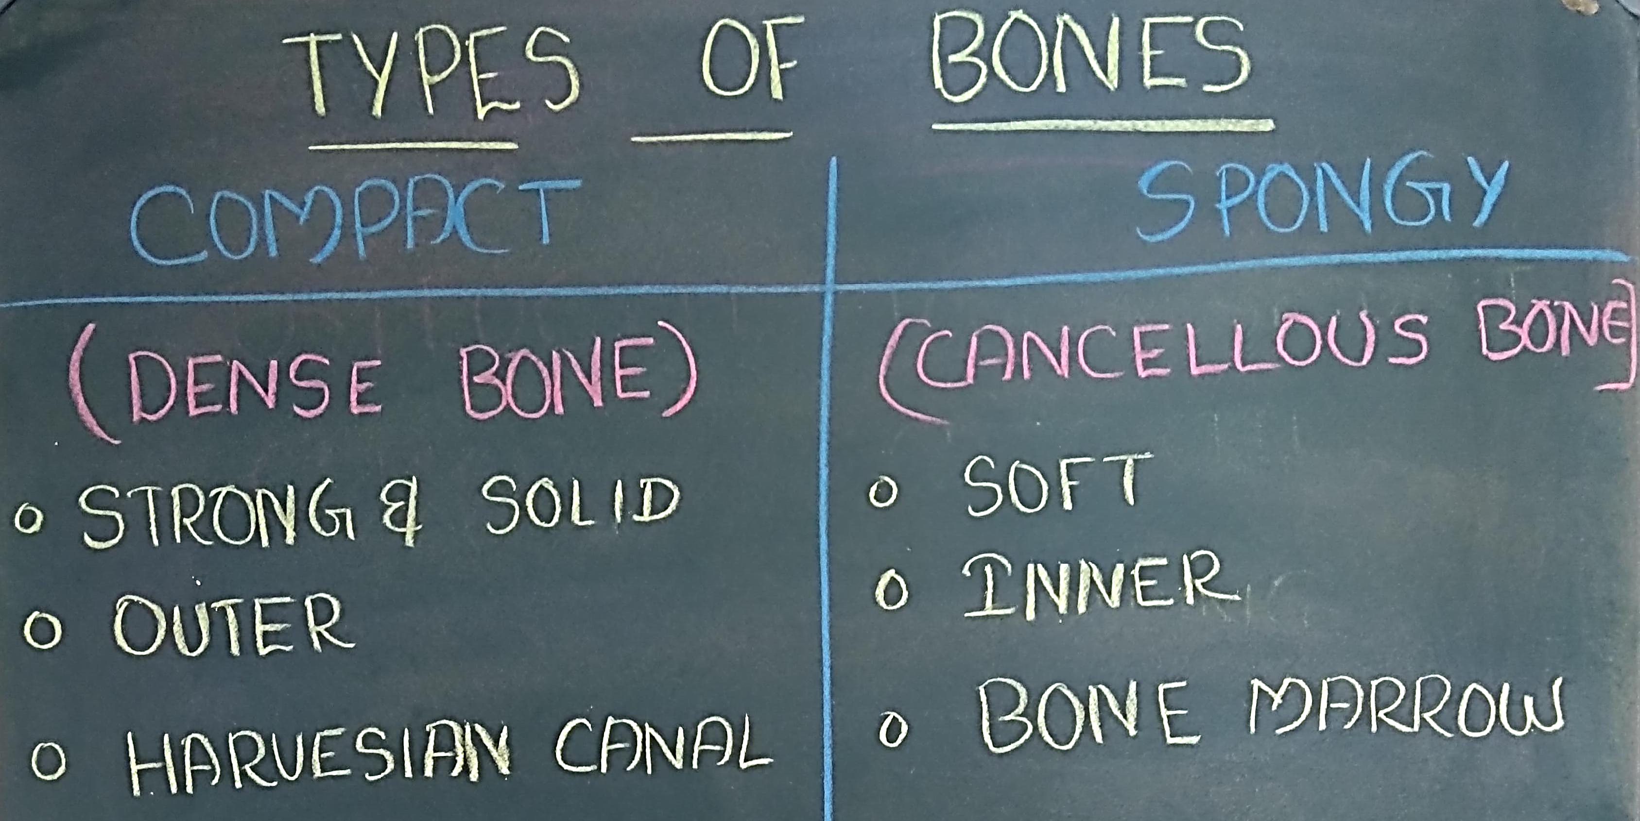
(cortical)

Slide 8
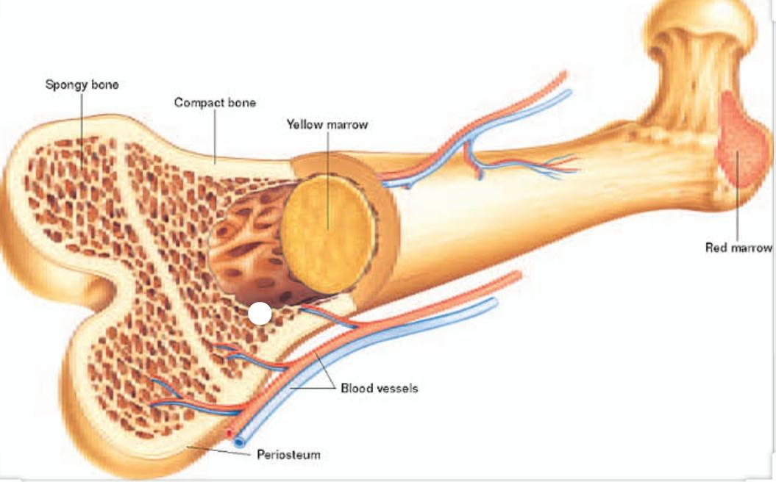

Slide 9
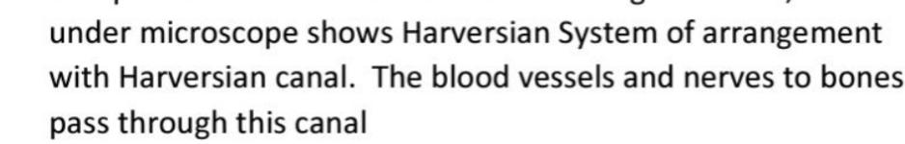
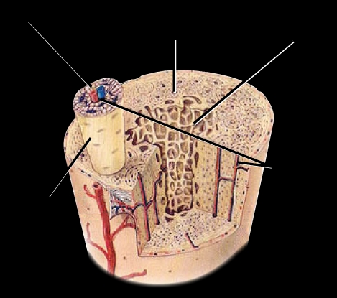
Harversian canal

Slide 10
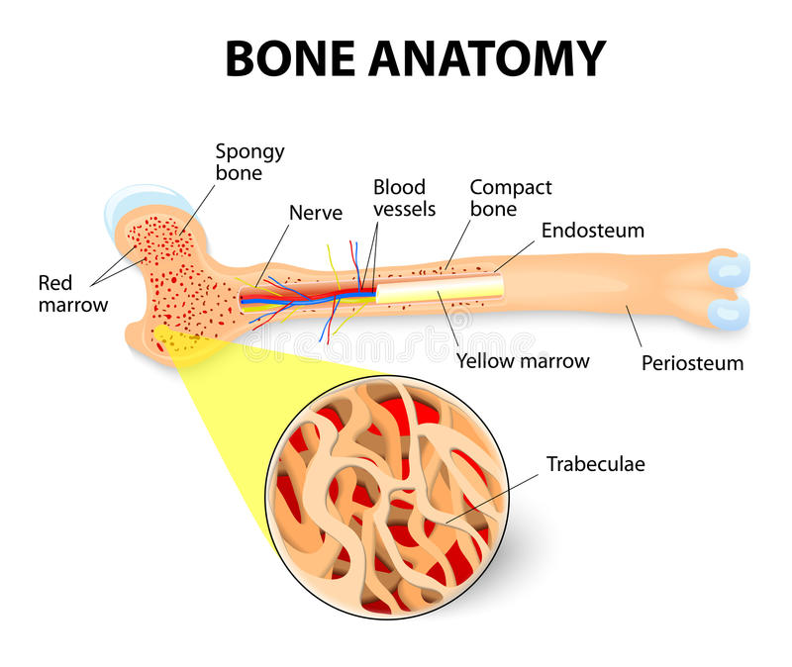
TrabEculae
Cells arranged in a mesh network

Slide 11
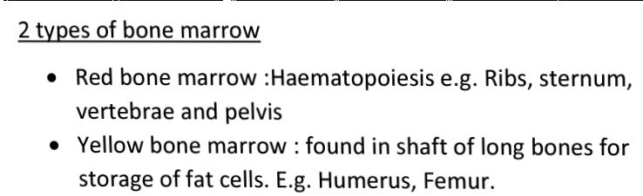

Slide 12
CLASSIFICATION OF BONES
1. Long bones
2. Short bones
3. Flat bones
4. Irregular bones
5. Sesamoid bones

Slide 13
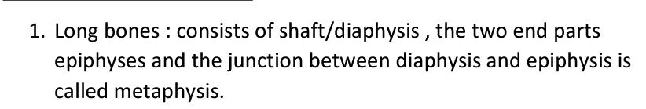
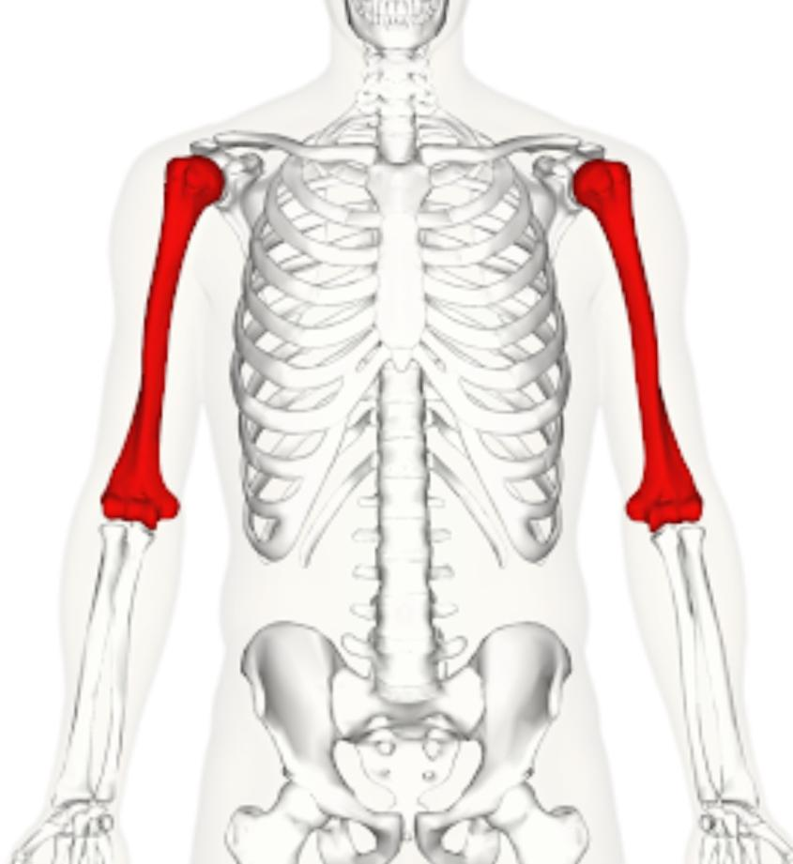
Long bones
Tubular in shape
Eg:- Humerus
Femur

Slide 14
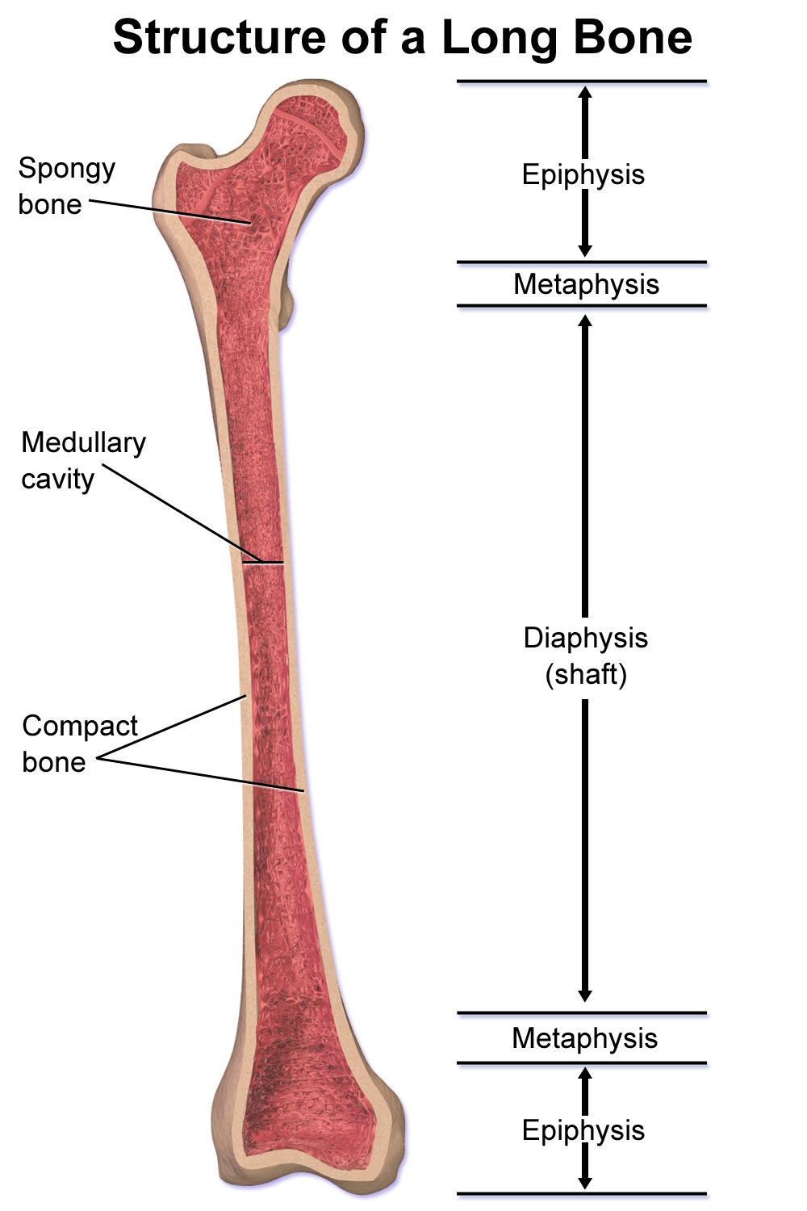

Slide 15
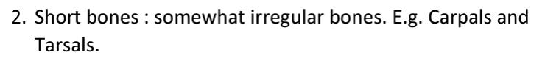
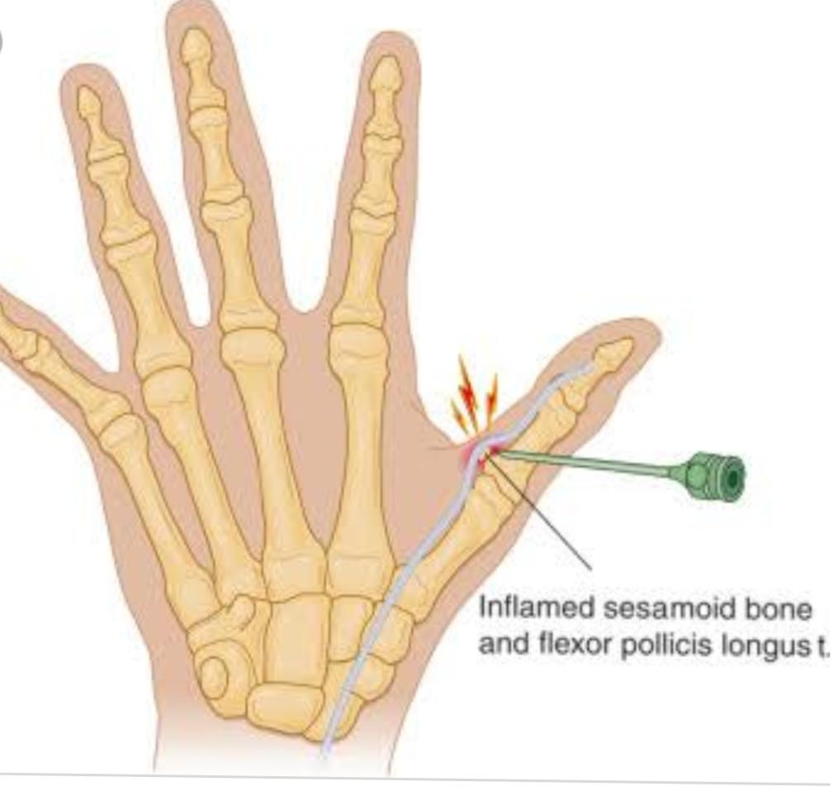
Short bone
Cuboidal in shape.
Eg:- Wrist
Ankle

Slide 16
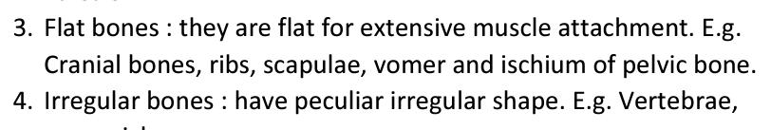
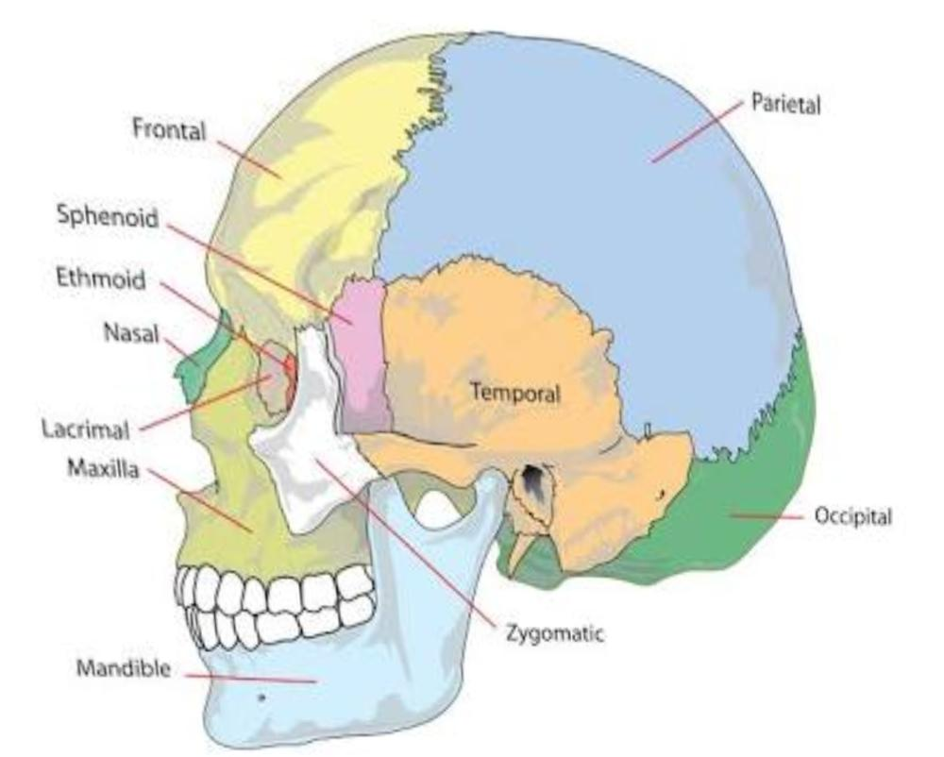
Flat bone
Flat bone plates
Eg:- Skull

Slide 17
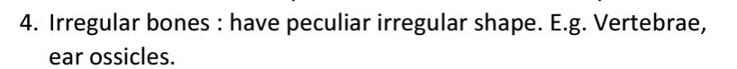
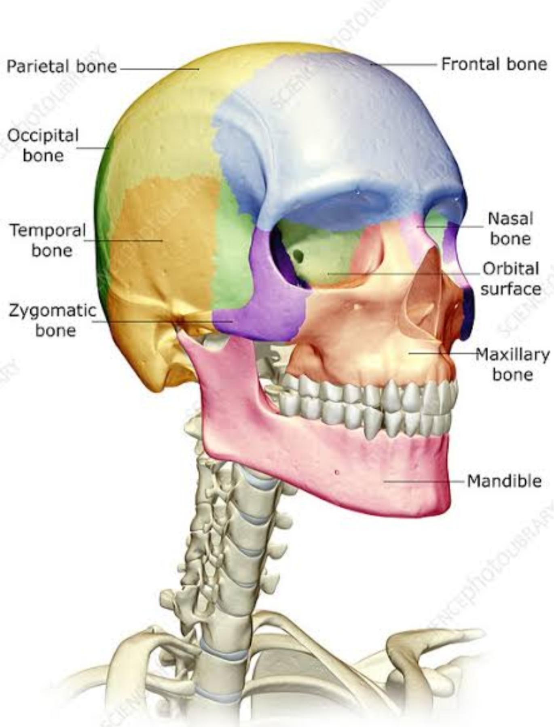
Irregular bones
Of various shape
Eg:- Bones of face

Slide 18
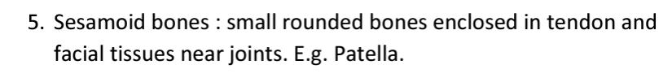
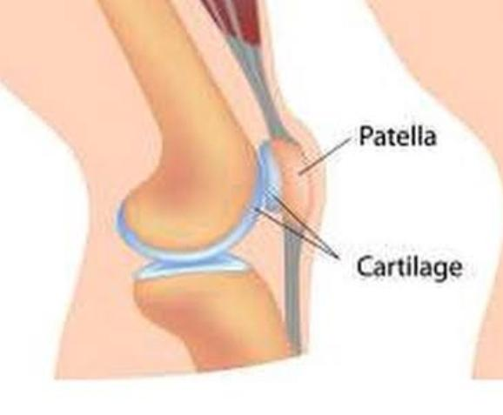

Sesamoid bone
Round / oval in shape
Eg:- Small bones develop in tendon.

Slide 19
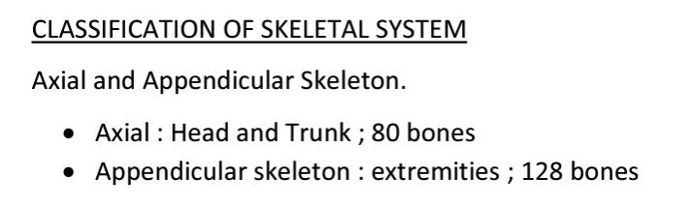
126 Bones

Slide 20
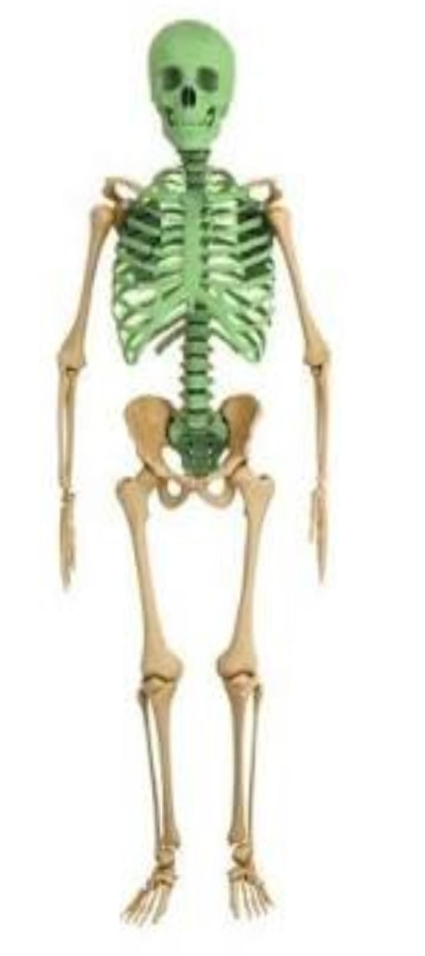
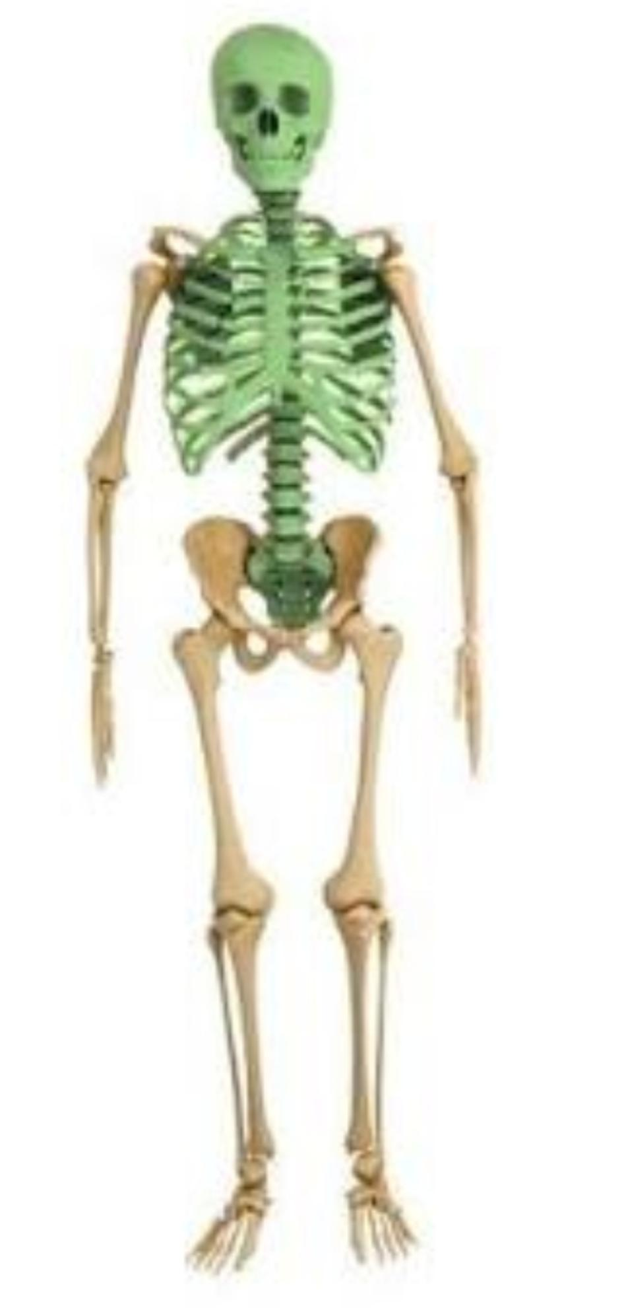
AXIAL SYSTEM

Slide 21
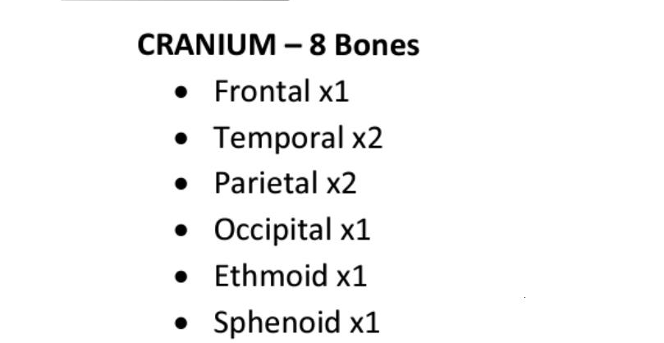

Slide 22
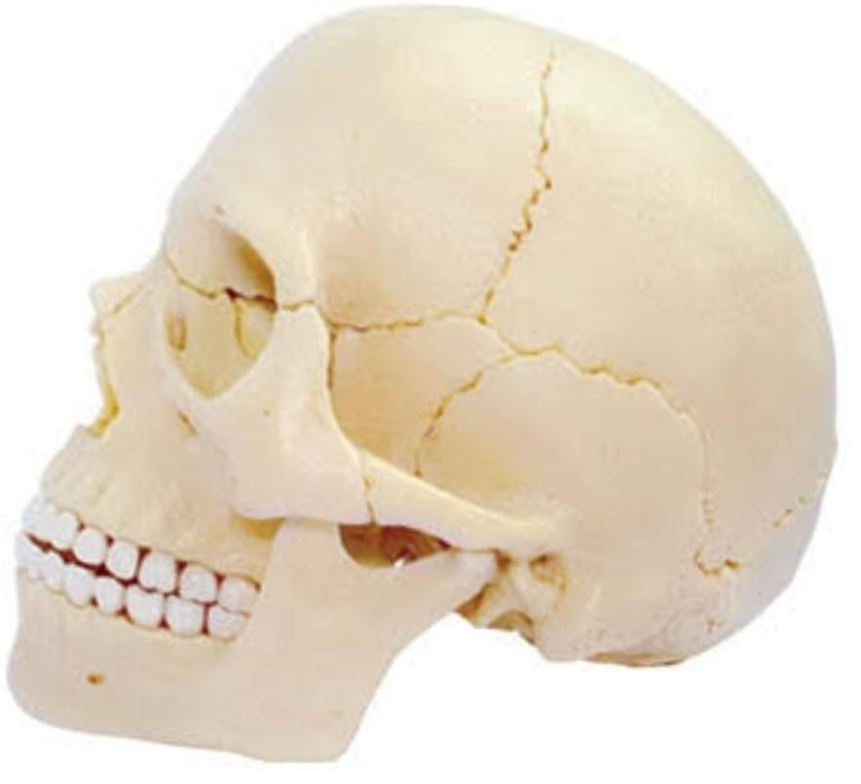
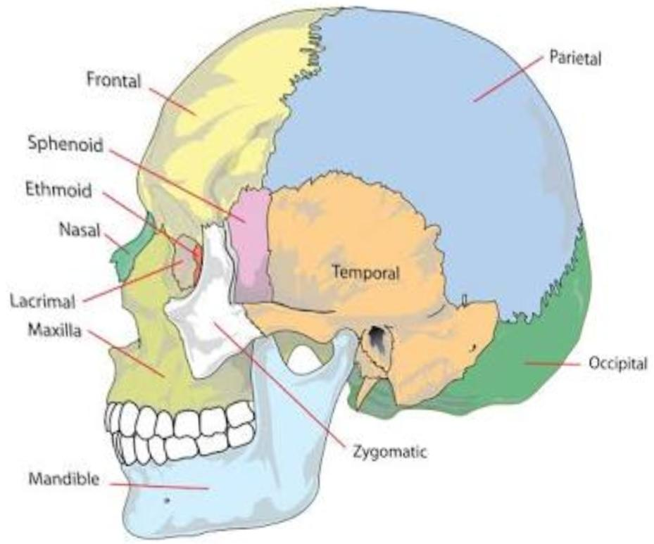
SKULL
Many bones of the head collectively form the skull.
Most of these are interconnected by sutures which are immovable fibrous joint.

Slide 23
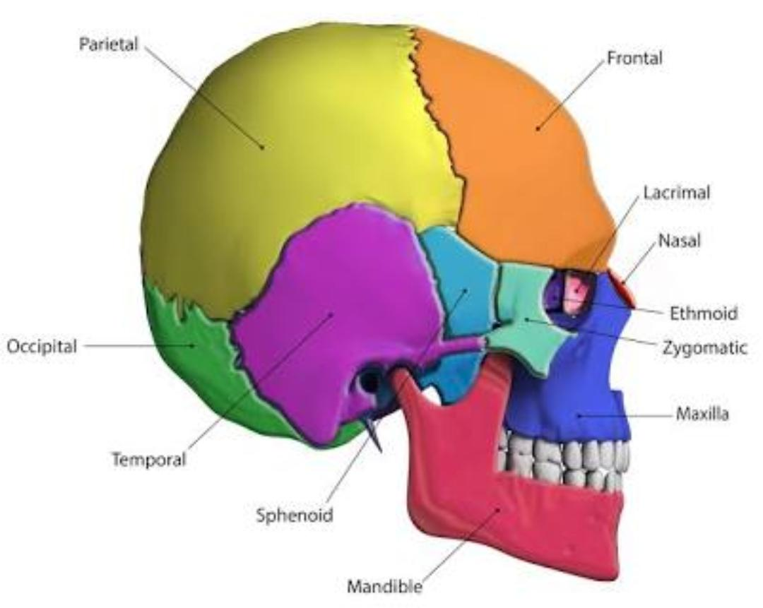
Bones of skull
Frontal
Parietal
Occipital
Temporal
Sphenoid
Ethmoid

Slide 24
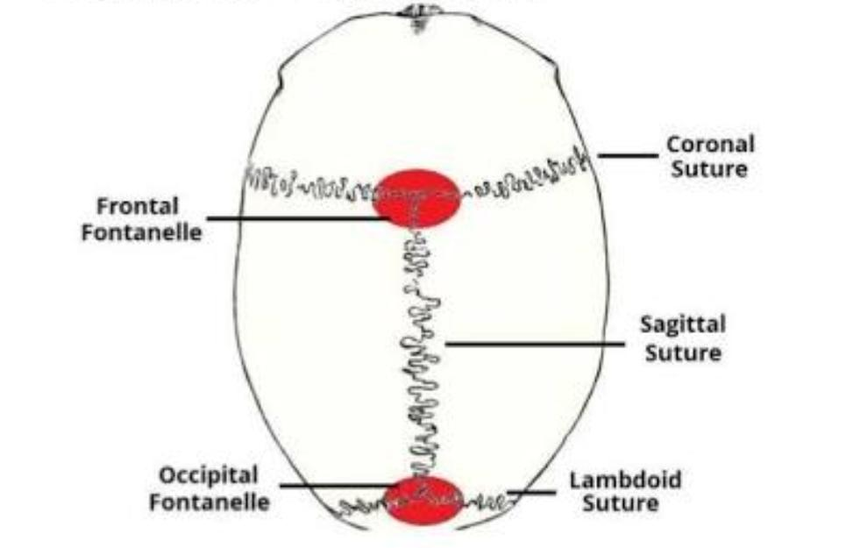
Sutures of skull
Coronal suture
Sagittal suture
Lambdoid suture

Slide 25
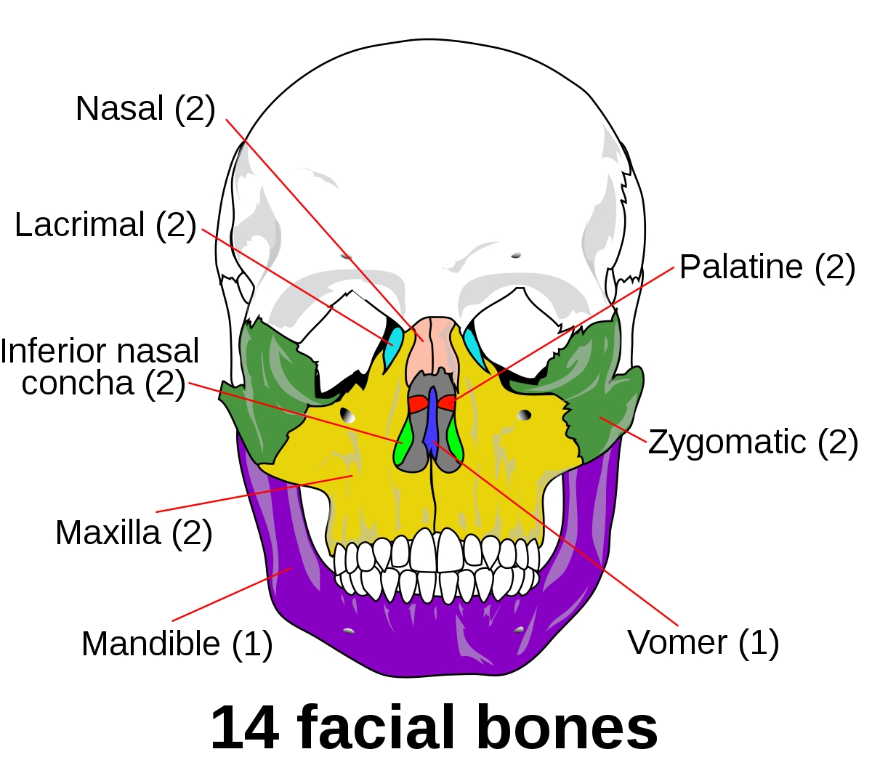
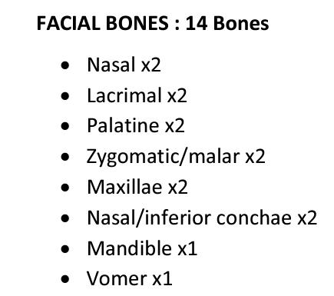

Slide 26
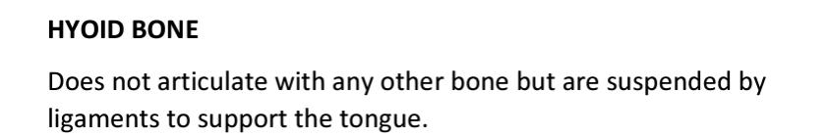
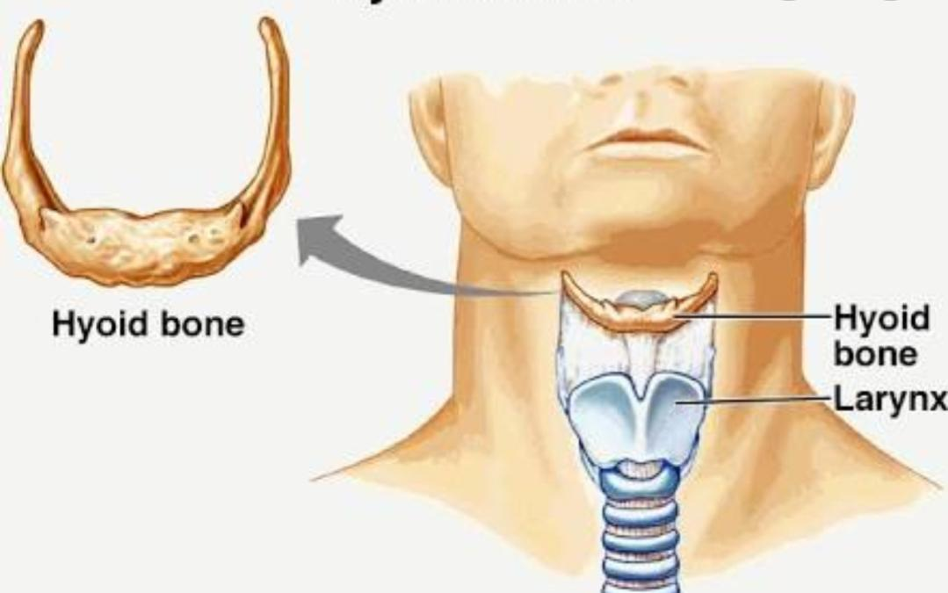

Slide 27
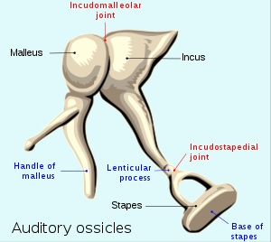
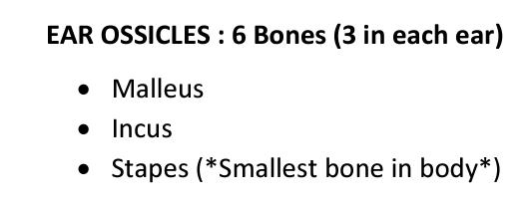

Slide 28
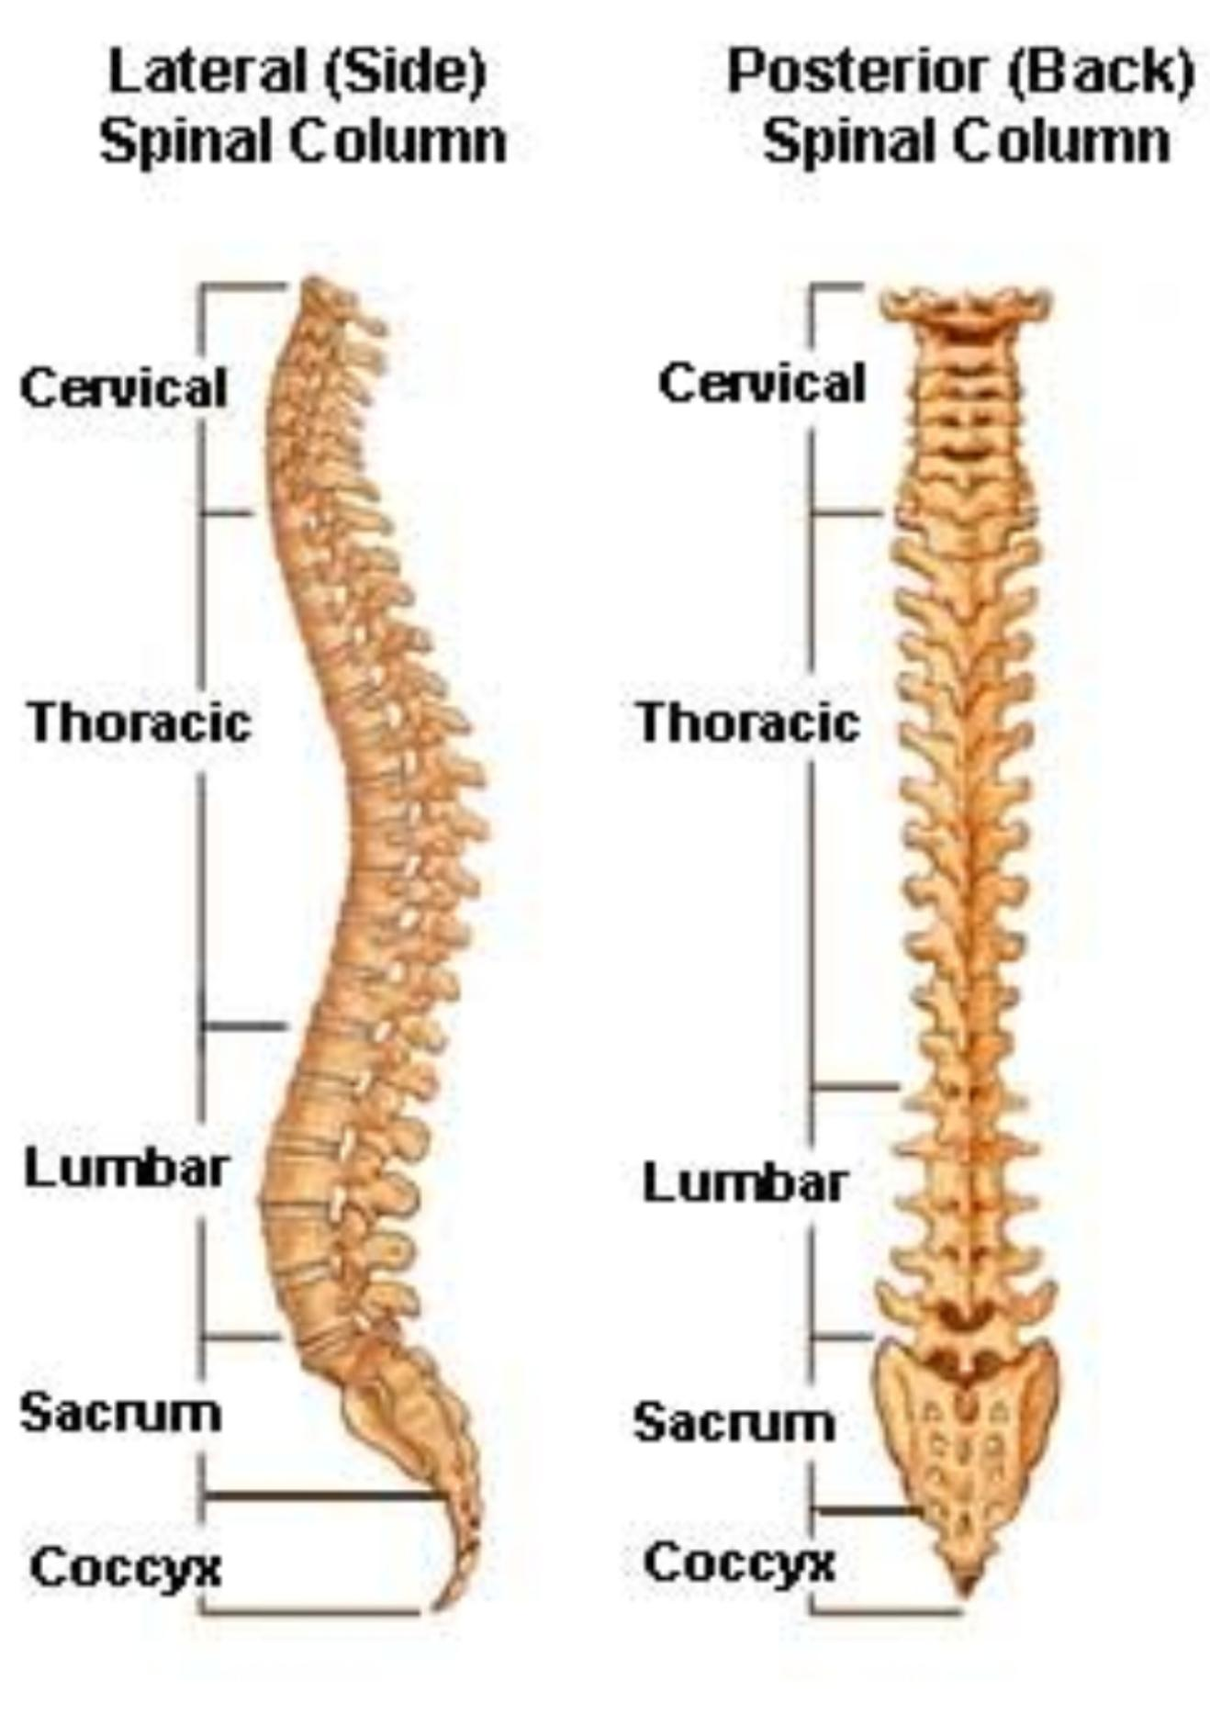
Vertebral column
Cervical – 7
Thoracic – 12
Lumbar – 5
Sacrum – 5 fused
Coccyx – 4 fused
Total number of verterae – 33
Vertibra : singular
Vertibrae : plural

Slide 29
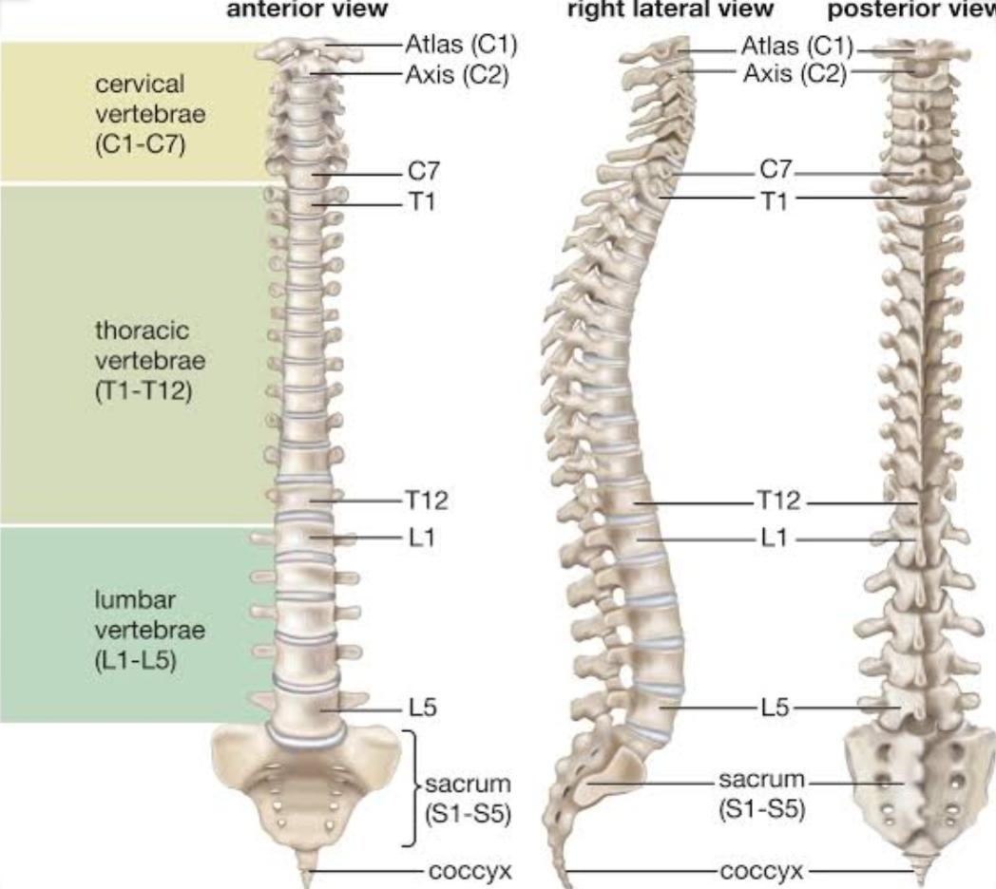
Names Of Vertebrae

Slide 30
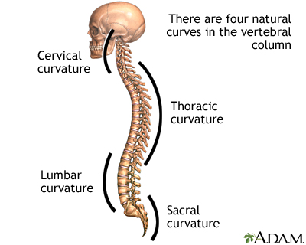
Primary curves
The thoracic and sacrococcygeal curves
Are retained from the original fetal curvature.
Secondary curves
The cervical and lumbar curves
Develop after birth

Slide 31
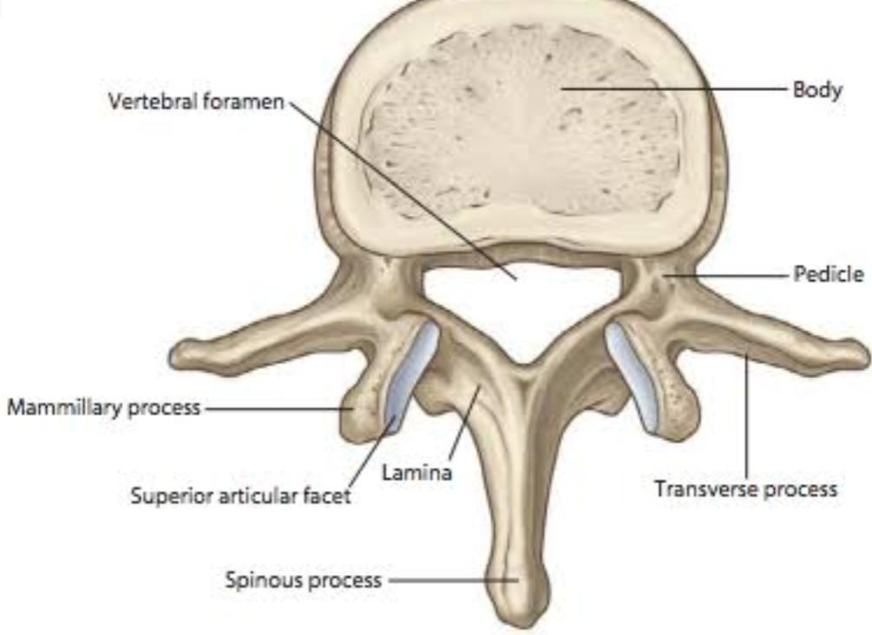
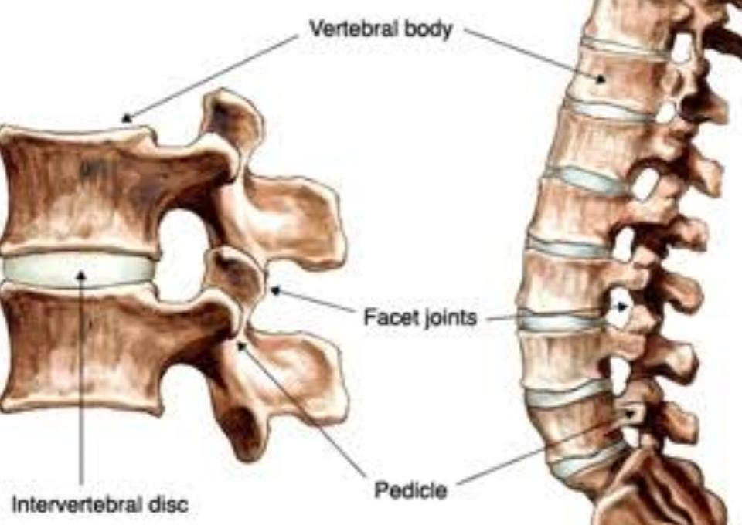
Structure of a vertebra
Inter vertebral disc lies in between each vertebrae to reduce the ware and tare

Slide 32
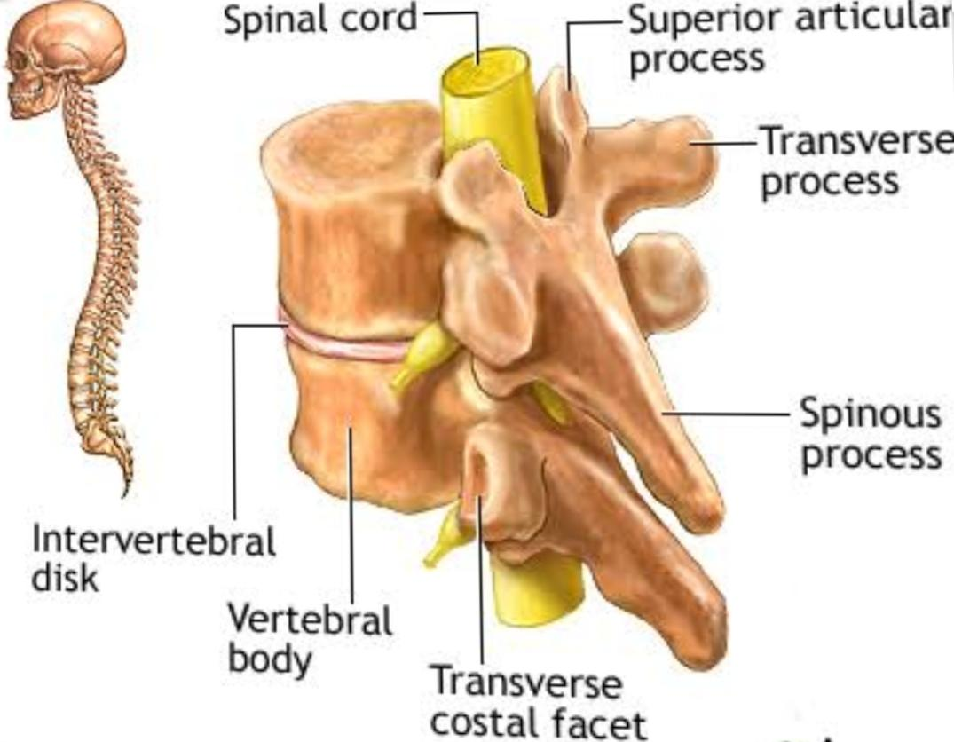
Vertebral column and Spinal chord
Spinall chord passes through the vertebral column.

Slide 33
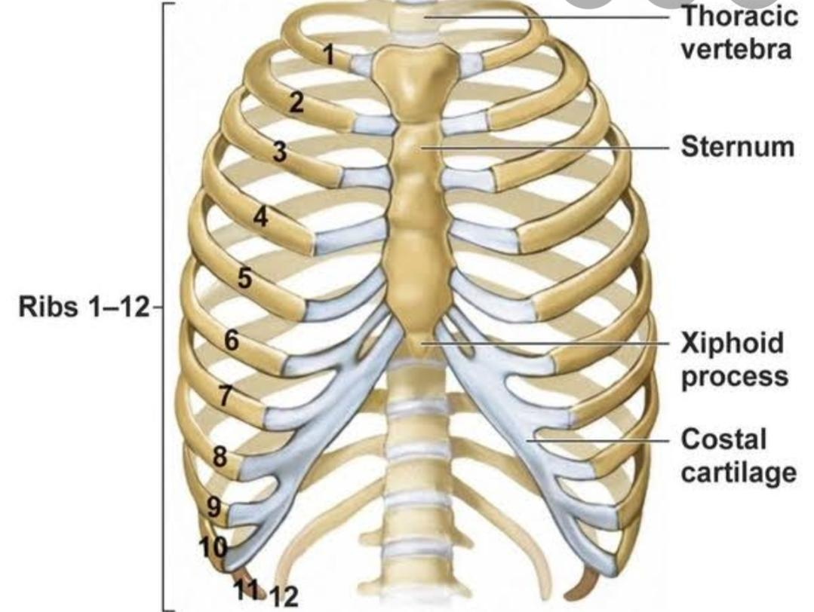
Ribs
Number of ribs – 12 pairs
Types of ribs
1. True ribs : Articulate directly with sternum
2. False ribs : Doesn’t articulate
a. 8-10th rib :- articulate with costal cartilage
b. 11th and 12th rib(Floating ribs) :- No anterior connection

Slide 34
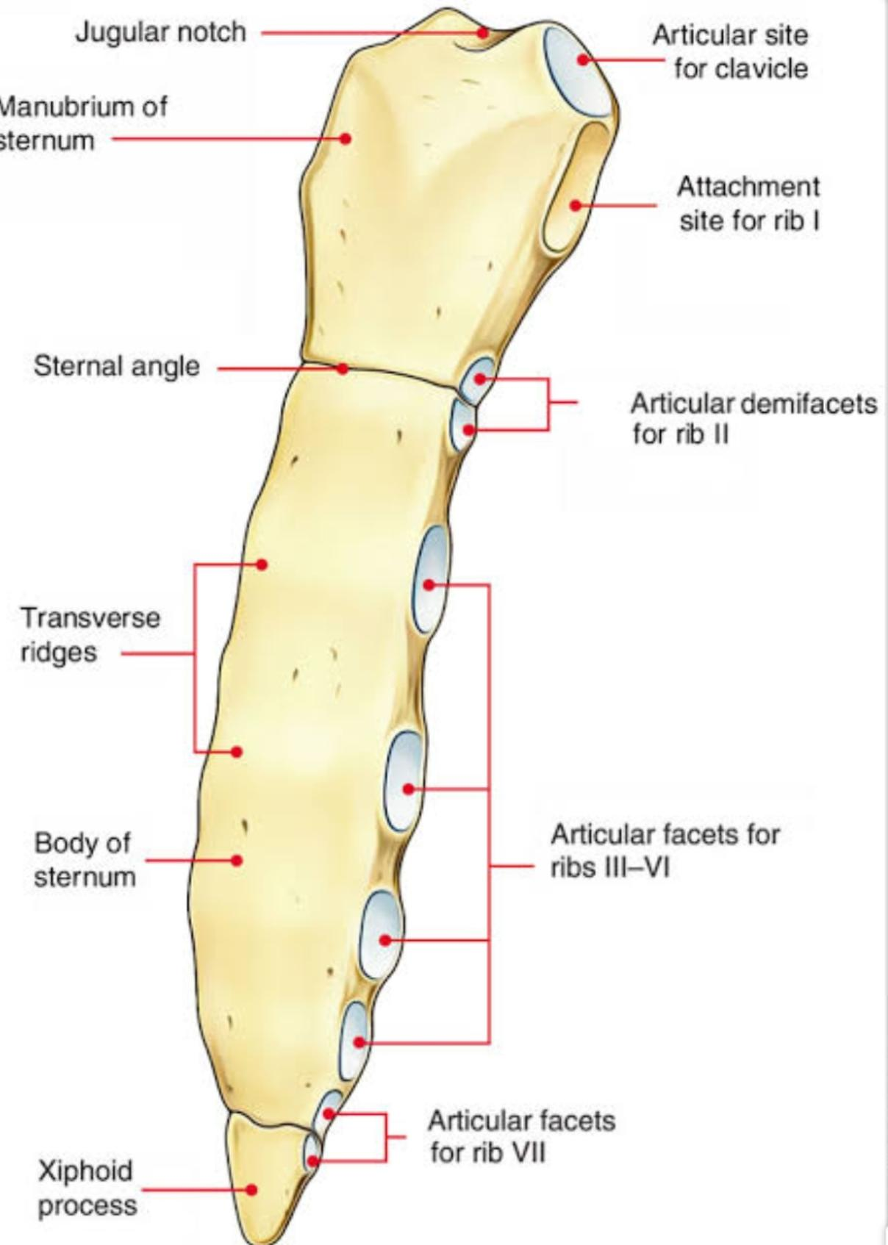
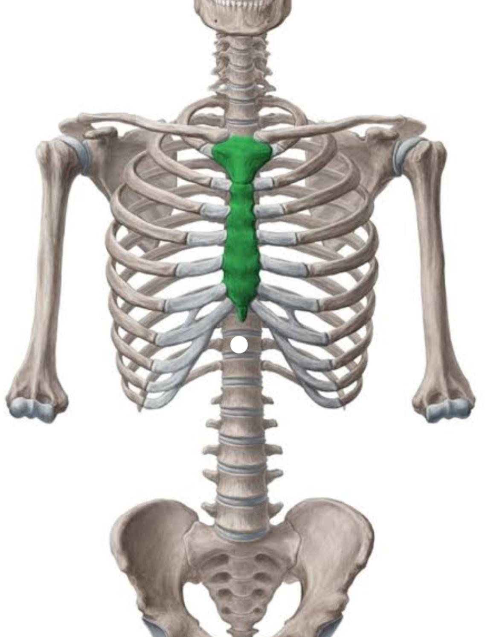
Sternum

Slide 35
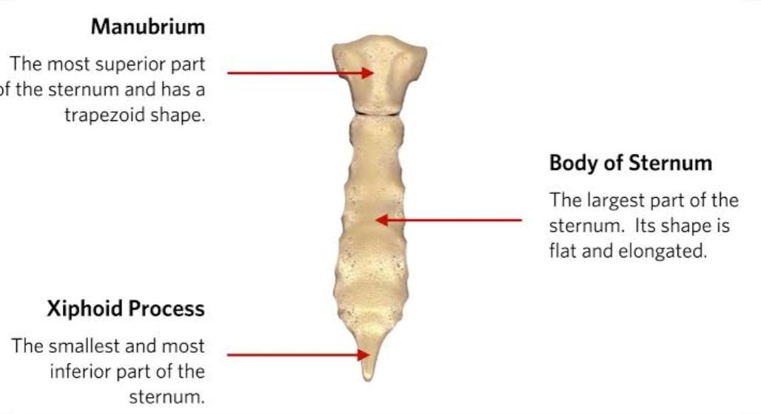

Slide 36
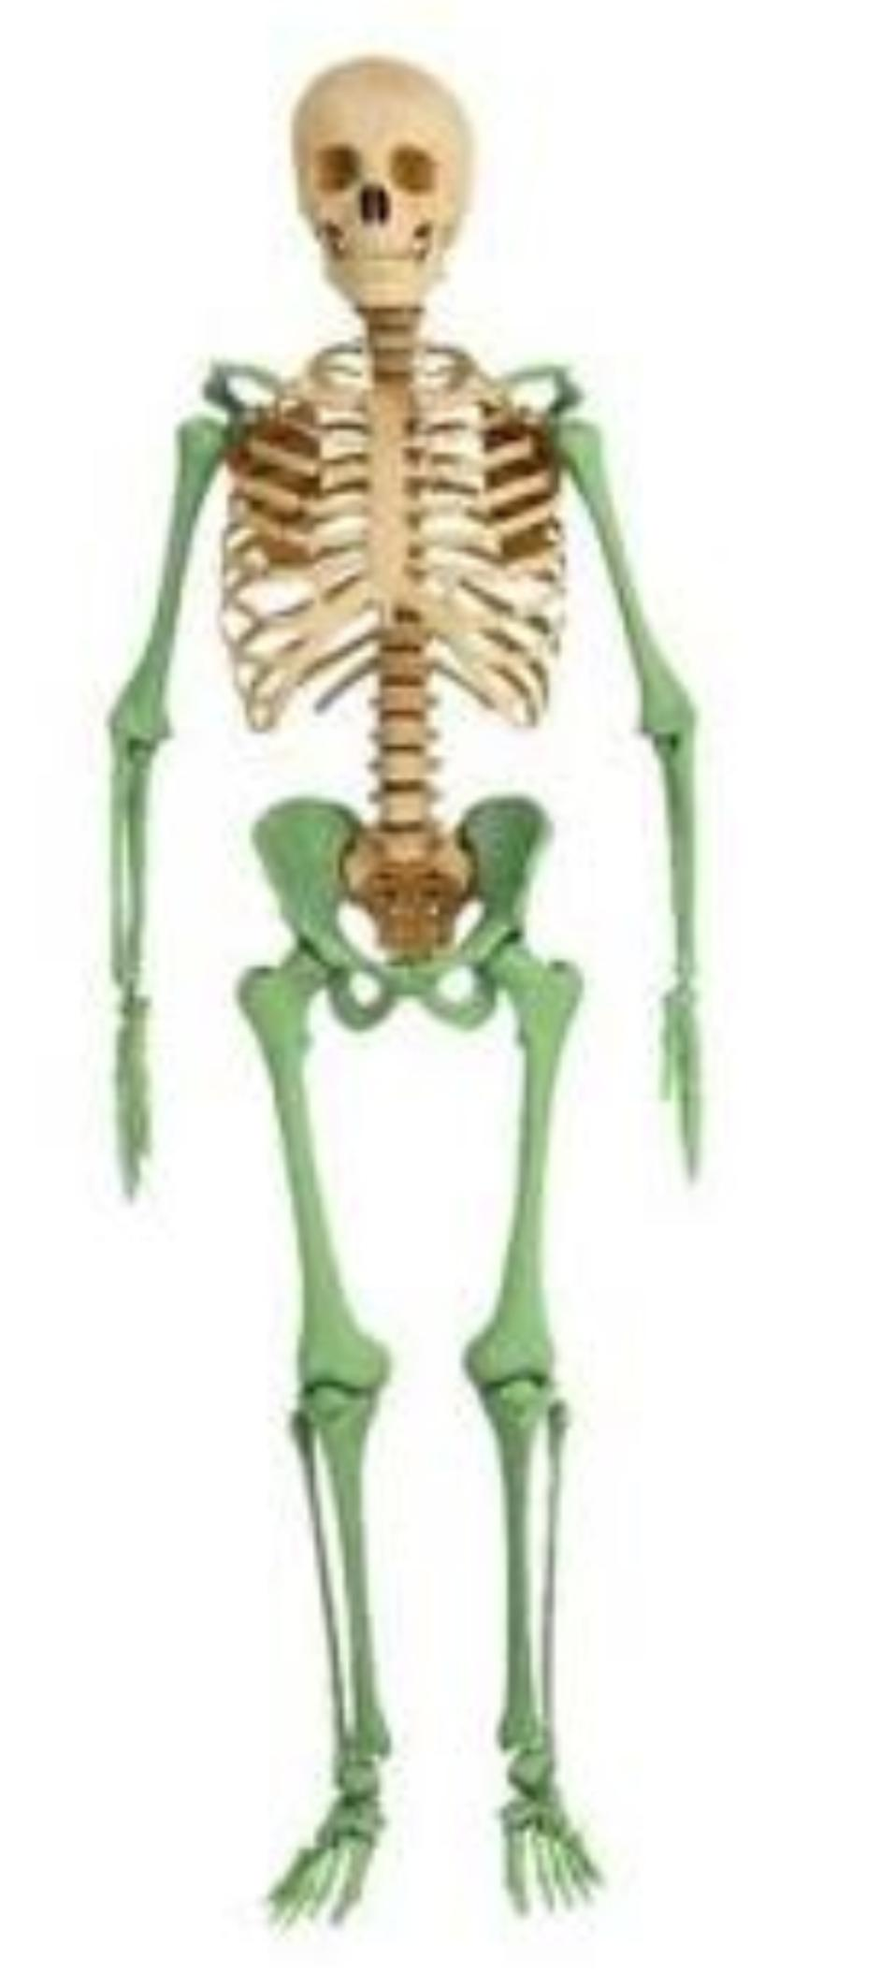
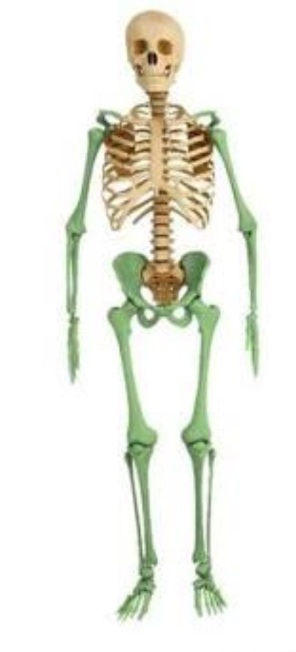
APPENDICULAR SKELETAL SYSTEM

Slide 37
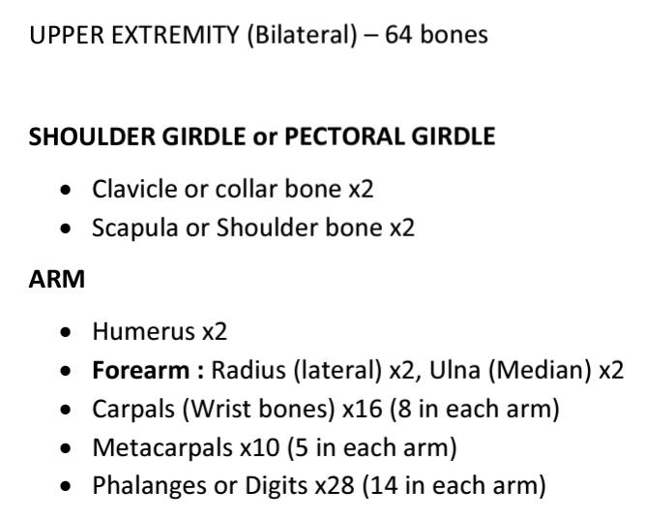

Slide 38
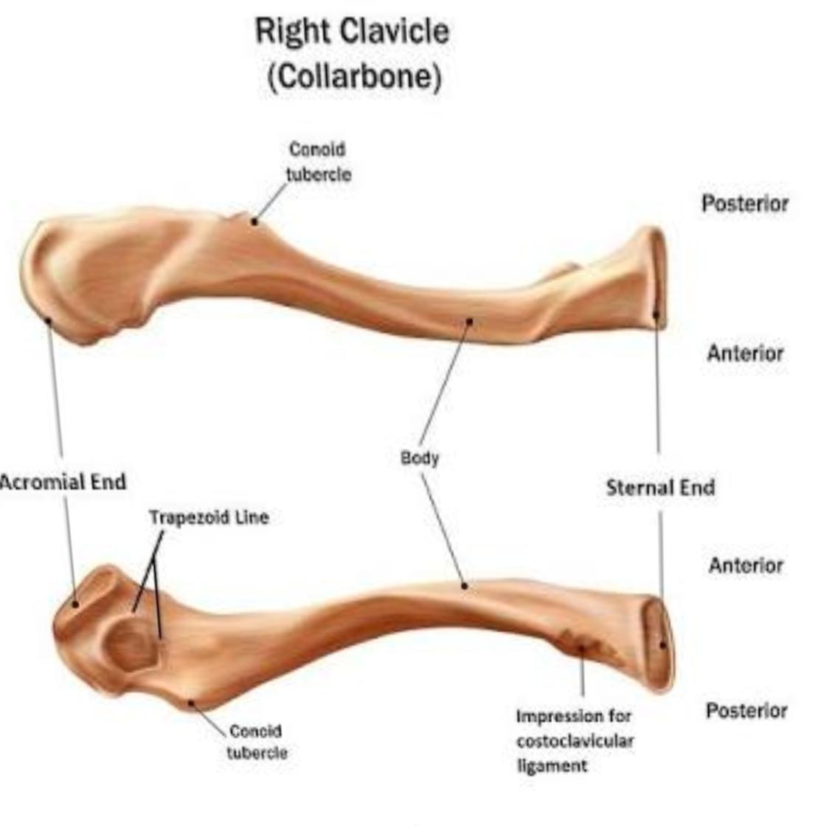
Clavicle

Slide 39
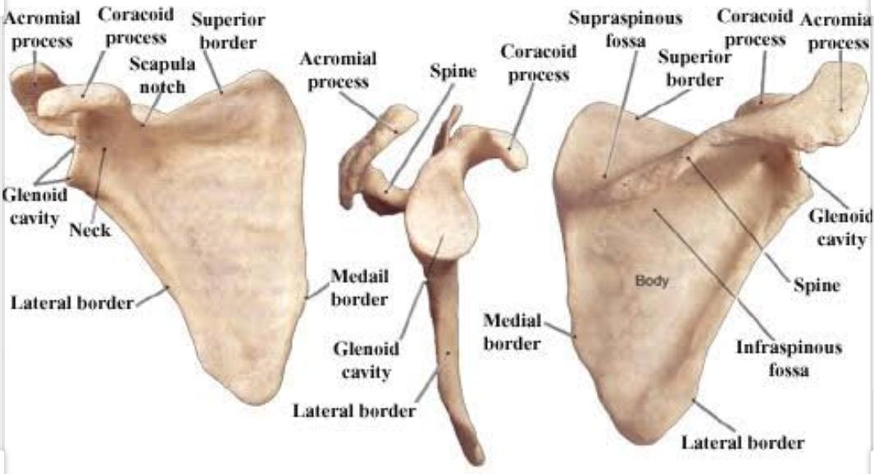
Scapula

Slide 40

Bones of upper limb
Clavicle
Scapula
Humerus
Radius
Ulna
Carpal
Metacarpal
Phalanges

Slide 41

Humerus

Slide 42

Radius and ulna

Slide 43

Carpal bones
Scaphoid.
Lunate.
Triquetrum.
Pisiform.
Trapezium.
Trapezoid.
Capitate.
Hamate

Slide 44

Metacarpal bones

Slide 45

Phalanges

Slide 46



Slide 47

Pelvic bones

Slide 48

HIP BONE
The left and right hip bones are two irregularly shaped bones that form part of the pelvic girde.
Parts
Ilium
Ischium
Pubis
Also known as..
innominate bones
pelvic bones

Slide 49

Bones of lower limb
Pelvic bones
Femur
Patella
Tibia
Fibula
Tarsal
Metatarsal
Phalanges

Slide 50

Femur

Slide 51

Patella

Slide 52

Tibia and fibula

Slide 53

Tarsal bones
Tarsal bone are
calcaneus,
Talus
Cuboidd
Navicular
Medial cuneiform
Middle cuneiform
lateral cuneiform

Slide 54

Metatarsal bones

Slide 55

Phalanges of foot

Slide 56
Disorders

Slide 57



Slide 58



Slide 59



Slide 60



Slide 61



Slide 62



Slide 63



Slide 64



Slide 65



Slide 66



Slide 67


